Slide 1

PROJECT 1 – Should Students be EMPOWERED to Choose Their State-Sponsored Test?
Deepankar sharma

Slide 2
Contents
Overview
Problem Statement
Who should take the ACT?
Who should take the SAT?
Which states mandate which test?
% of High School Grads going to College across all states
How do ACT-mandated states perform in College admission?
How do SAT-mandated states perform in College admission?
Do most states that mandate either test have a high % of students that get into colleges?
EMPOWER students to choose their state-sponsored test?

Slide 3
Overview
Colleges do not discriminate between applicants who have taken the SATs or ACTs
State mandate means that all state-administered SATs/ACTs are mandatory for eleventh-grade students
Paid-for and administered by the respective State Boards of Education
If a state mandates all students take one particular standardized test, students who would additionally like to take the other standardized test have do so on their own expenses.
The students should be able to decide which standardized test they’d like to be sponsored for by the state as both tests are formatted and scored differently.

Slide 4
Problem Statement
Establish that a state's preference for mandating one test over the other has no bearing on the likelihood of high school graduates successfully gaining admission into college.
By studying the relationships between
(1) Test participation (either SAT or ACT)
(2) percentage of high school graduates that gained admission into college
If no correlation between either test and college admission, it means that mandating an entire state to take one type of test is not made in the interest of students.

Slide 5
Who should take the ACT?
Scientific data, graphs, and hypotheses
Struggle to solve math quickly without a calculator
Much larger focus on geometry (30-45% of ACT Math)
Matrices, graphs of trig functions, and logarithms
Math accounts for only 1/4 of your total score
If you're not a fan of open-ended math questions
Reading questions are always separate from one another
Good reading comprehension skills (Optional Essay)
Strong rhetorical skills too (Optional Essay)
Give ample evidence to support your perspectives on issues (Optional Essay)

Slide 6
Who should take the SAT?
SAT offers more time per question on all sections of the exam
Good enough at math to work fast without a calculator
Good at algebra and data analysis
SAT provides you with a diagram of math formulas
Math accounts for half of your total score
Evidence-support questions in a chronological order
SAT Reading questions are generally easier to follow
Chronologically ordered questions save you time on the SAT

Slide 7
State-Mandated Tests
ACT:
Alabama
Hawaii
Idaho
Kentucky
Louisiana
Mississippi
Missouri
Montana
Nebraska
Nevada
North Carolina
North Dakota
Ohio
South Carolina
Tennessee
Utah
Wisconsin
Wyoming
SAT:
Colorado
Connecticut
Delaware
District of Columbia
Idaho
Illinois
Maine
Michigan
New Hampshire
Ohio
Tennessee

Slide 8

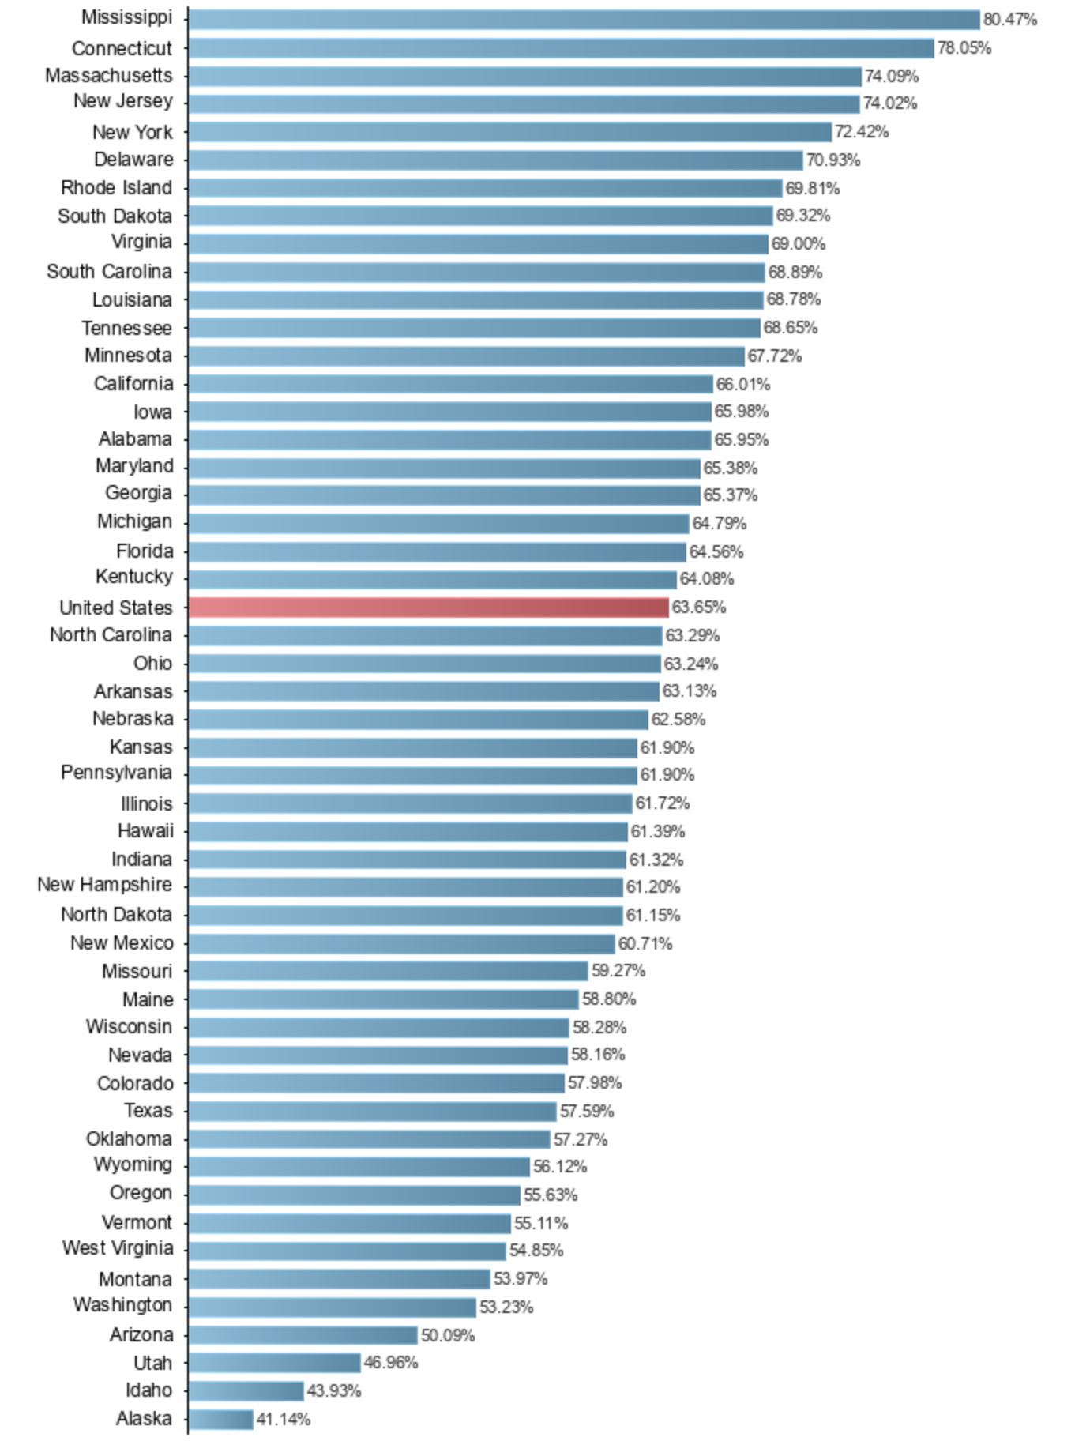
High School Grads going to College
ACT-mandated states with ≥ 65%:
Mississippi
South Carolina
Louisiana
Tennessee
Alabama
SAT-mandated states with ≥ 65%:
Connecticut
Delaware
Tennessee

Slide 9
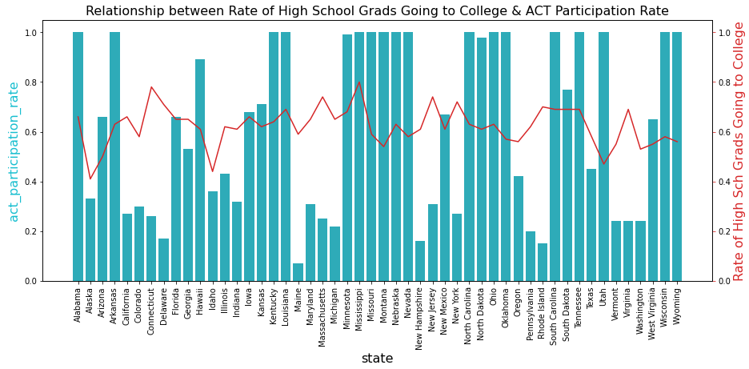
ACT-mandated states’ performance in College admission
Only 5 / 18 states had 65% or more high school graduates get into college
Mississippi the only exceptional performer

Slide 10
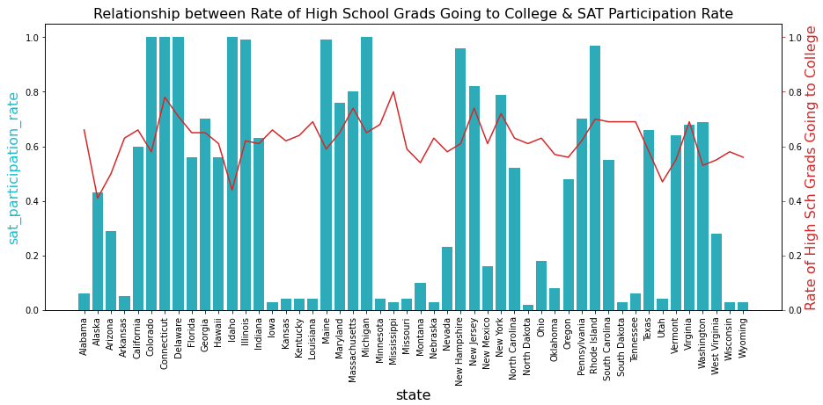
SAT-mandated states’ performance in College admission
Only 3 / 11 states had 65% or more high school graduates get into college
Connecticut the only exceptional performer

Slide 11
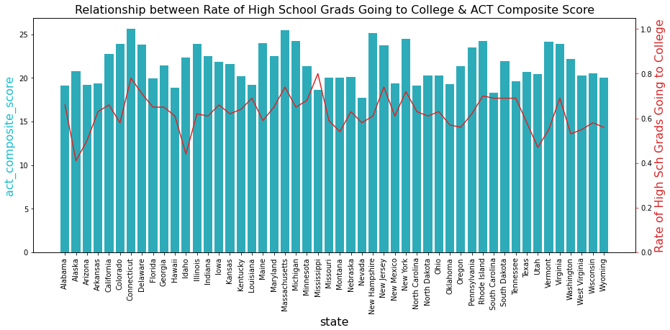
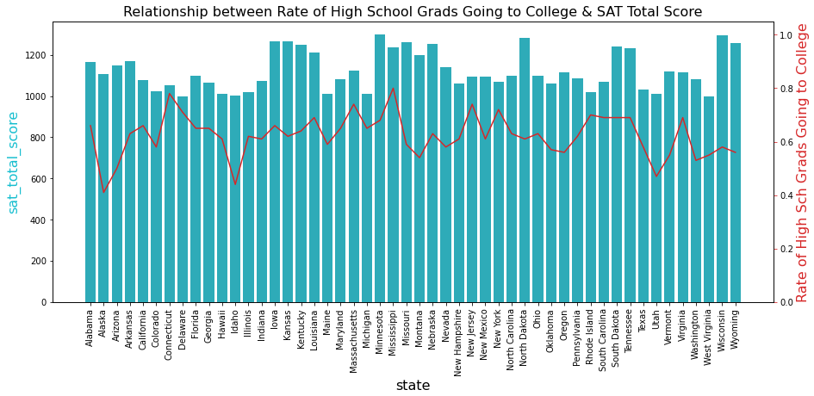
College Admission Rates vs ACT and SAT Scores
Connecticut and Missouri the only outstanding states with high test participation rates, high test scores, and high college admission rates.
There is no data amongst other states to support any basis for the mandate of one standardized test over another.

Slide 12
EMPOWER students to choose their state-sponsored test?
Having studied the relationships between percentage of college going high school graduates, standardised test participation rates, and standardised test scores, other than the “outliers” of Connecticut and Missouri (who have done exceptionally in all three categories), there is no evidence to support why certain states enforce upon students only one type of mandatory test.
States like Idaho and Tennessee are leading by example in making it mandatory for students to sit for either ACT or SAT as part of their high school graduation requirement. This gives students the fair choice of being able to sit for a test that they feel more capable of excelling in.
We can understand the need for standardised tests as a level playing field for students from different backgrounds, but we cannot understand the state’s decision to enforce which test they should take.

